Slide 1
SDG 15.4.1: Tracking Mountain Biodiversity
Amina Ly
July 23, 2021

Slide 2
Mountain biodiversity is under extreme threat across the globe
Rahbek et al. 2019
Notes:
25% of all land area, mountain regions are home to more than 85% of the world’s species of amphibians, birds, and mammals,
many entirely restricted to mountains
Across the world, there are scientists, policy makers, and ecologists (among others) committed to protecting and tracking biodiversity

Slide 3
How do we track global progress protecting mountainous key biodiversity areas around the world?
Notes:
Why?
We now have a new dataset, and it allows us to focus on mountainous regions (which are threatened and high in biodiversity) (find figure of biodiversity declining in mountainous regions)

Slide 4
Key Data Sources Include:
Key Biodiversity Areas (KBAs)
WCMC World Database on Protected Areas (WDPA)
Global Mountain Biodiversity Assessment Mountain Inventory (GMBA)
Notes:
TODO: Better example of the dataset with a legend
2 idealized examples and walk through them (+ a legend)
Explain each of the maps/datasets quickly

Slide 5
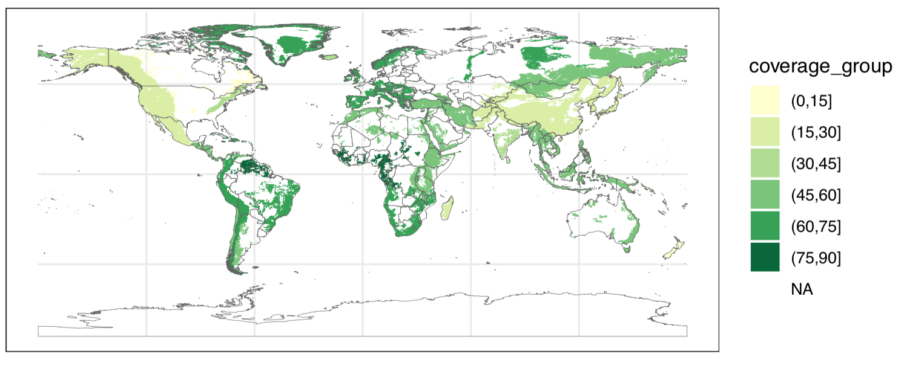
Communicating current progress on protecting mountainous regions
Notes:
Aggregated results
Point out a mountain range or two

Slide 6
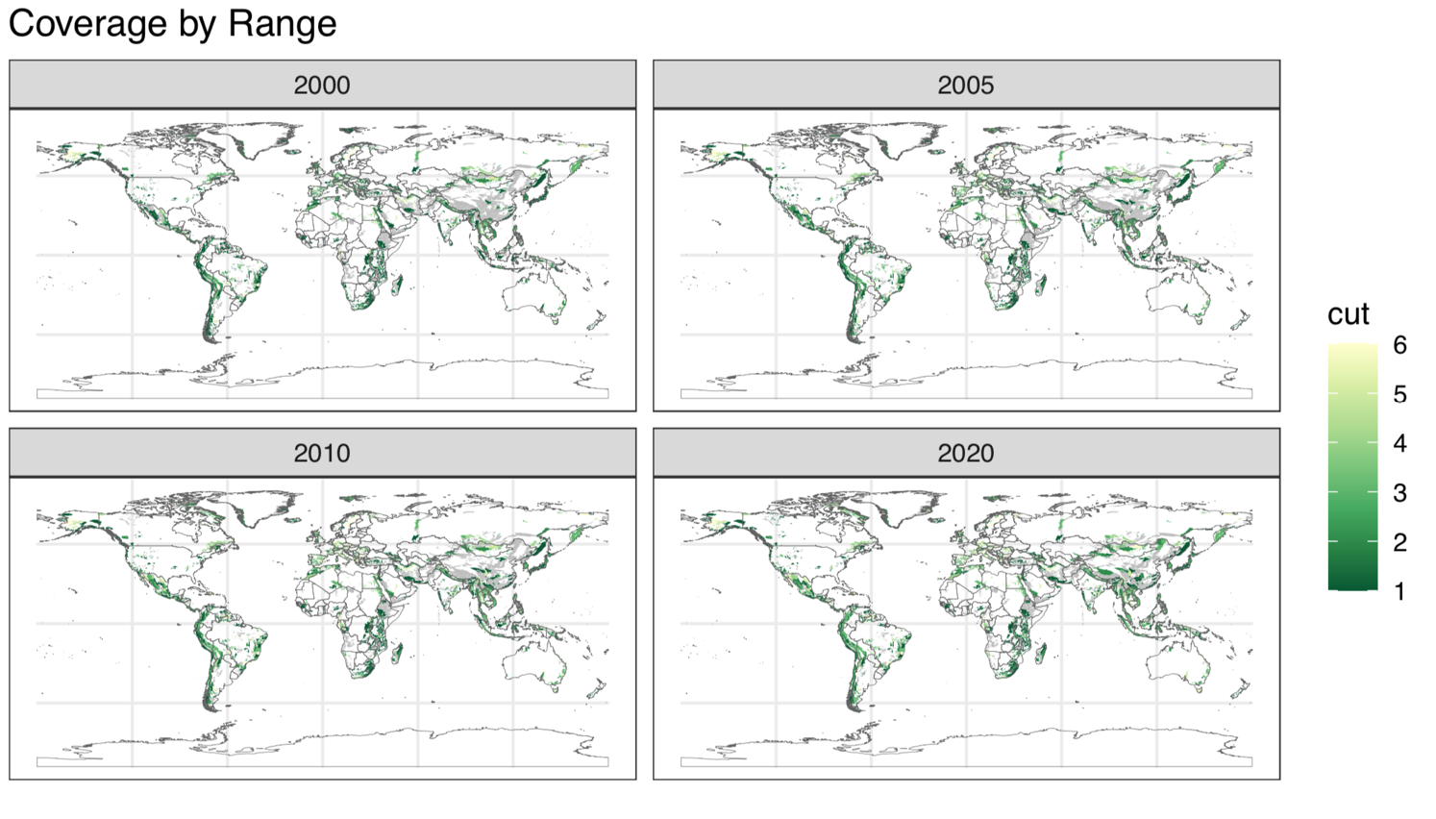
Glimpse into the evolution of coverage through time
Notes:
We even can see the evolution of coverage through time, and the time periods in which different areas of the world have built up their protected areas. (THIS WILL BE A GIF IDEALLY)
Pick a continent

Slide 7
A whole new set of possibilities open up to explore progress on protections, and identify new threats to alpine biodiversity

Slide 8




Making this strategy accessible and reproducible for individual use
Online interface to communicate results
Can be combined with climate data to explore climate change vulnerability
Notes:
What is the future of this dataset?
1. make sure others can access and replicate this standard. Planning to at least have a github repo
2. create a web app for people to explore the result of the data. For those familiar, RStudio allows you to do this using by creating a shiny application
3. this can be done using current/historic data from satellites or even using future projections/scenarios

Slide 9


Thank You!
Global Sustainability Scholars
Global Mountain Biodiversity Assessment (GMBA) Team:
Davnah Urbach; Mark Snethlage; Jonas Geschke
Birdlife International
Ashley Simkins
UNEP WCMC
Cristina Lazaro
aminaly@stanford.edu
@amina6_26
Notes:
Amina, Stanford PhD Candidate; learned the incredible amount of man power that goes into these seemingly simple calculations and tracking projects

